Slide 1
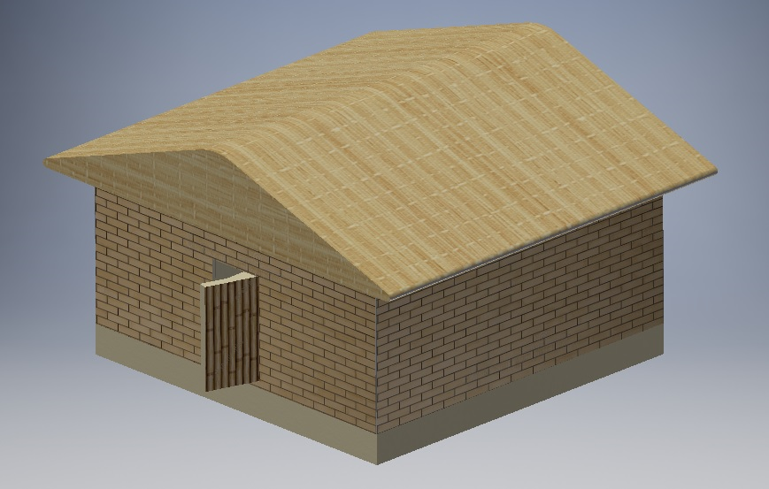
Low Cost Earthquake Resilient House: The Design Process
Group 3: Tina, Grace, Anhad
Notes:
Hey guys, my name is Grace Mascarenhas (introduce) we’re group 3. Today we will be looking at our design for an earthquake resilient house. I will start us off by taking you through how we modelled the problem, followed by Sam who will go more into depth for the main features of our house and to finish us off Tina will summarise our final design.

Slide 2
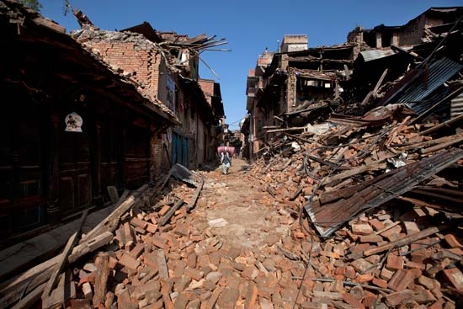
Introduction
The 2015, magnitude 7.8 earthquake that hit Nepal had devastating effects that the locals still live with today.
This presentation introduces a design for a low-cost, earthquake resilient house for the victims of the earthquake.
Some features include :
Thatched roof
Bamboo roof trusses
CSEB walls
Stone foundation
Image source : Niranjan Shrestha/AP Images
Notes:
The 2015, magnitude 7.8 earthquake that hit Nepal was one of the damaging as many of you would've seen the extensive news coverage. To this day Nepal is still reeling with the devastating effects of that earthquake, with a large majority of houses destroyed. The earthquake exposed the high demand for earthquake resistant housing, especially in a country that is constantly experiencing seismic movements. Now we are going to take a look at the design process we followed that allowed us to create a final design that consisted of the 4 features listed CSEB walls, Thatched roof, Bamboo roofing and foundation.

Slide 3

Product Design Specifications : Overview
The earthquake resilient house is to be…..
Able to withstand a ground acceleration of 0.4g
Within the budget of $5000 NZD
Constructed with local materials
Have sufficient space for a family of four
Livable between the temperatures of -10°C to 30°C
Gif Source: Gfycat
Notes:
()project objectives
The first steps of the design process was analysing the needs of the stakeholders and creating a PDS, product design specification. A few of the main specifications are listed here. The locals required safe housing, in the form of earthquake resistance for upto 0.4g ground acceleration. They also needed adequate space for a family of four . The isolated nature of the construction site meant that we had to utilise local materials, the temperature in mountainous nepal fluctuates between -10 to 30C so it was important the house had proper temperature control. The house must also be built within the constraint of the budget $5000 NZD and comply with local building code and safety standards.

Slide 4
Model Development : Weighing Matrix
Criteria | 1. | 2. | 3. | 4. | Total
1. Cost | - | 0 | 2 | 2 | 4
2. Safety | 2 | - | 2 | 2 | 6
3.Temperature Control | 0 | 0 | - | 1 | 1
4. Size | 0 | 0 | 1 | - | 1
Notes:
To analyse what our main priorities would be we used a weighing table . As you can see safety was our main concern. As mentioned before Earthquakes are very common in Nepal as we needed to ensure that the house would be able to withstand at least 0.4g of ground acceleration. Safety was followed closely by ….

Slide 5
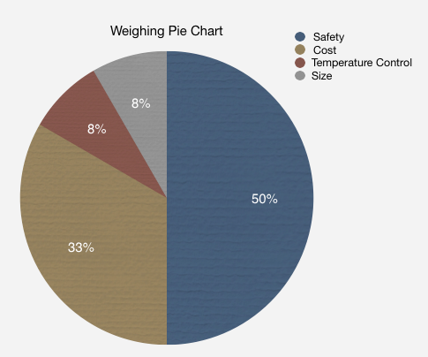
Notes:
This graph gives you a better grasp of the results from the weighting matrix. As you can see safety takes up the largest chunk

Slide 6
Morphological Analysis
Feature | Solution
Roof | Wooden Trusses | Thatched Straw | Bamboo Trusses
Roof Shape | Flat | Dome | Triangular
Body of House | Bricks (CSEB) | Bamboo | Reinforced Concrete
Foundation | Base Isolators | Rubble from Old houses | Concrete base
Temperature Control | Straw Thatching | Utilising high thermal mass of CSEB
Notes:
We used a morphological analysis to brainstorm possible solutions for each part of the house as seen on the slide before.

Slide 7
Outcome
01
Roof
Thatched Straw
Bamboo Trusses
02
Roof Shape
Triangular
03
Walls
CSEB Bricks
04
Foundation
Rubble of old house

Slide 8

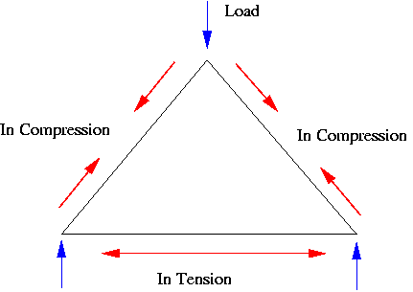
01
Roof
Thatched Straw
Bamboo Trusses
02
Roof Shape
Triangular
Images (Left to Right) Courtesy of Drew Weisholtz and
Notes:
-Thatching acts as a natural umbrella, reflects off any rain or snow
-triangular because triangles have the property of bearing large loads without deformation, if we made it flat, rain and snow would settle, cause it to deform.
-Bamboo not brittle. Sturdy yet flexible

Slide 9
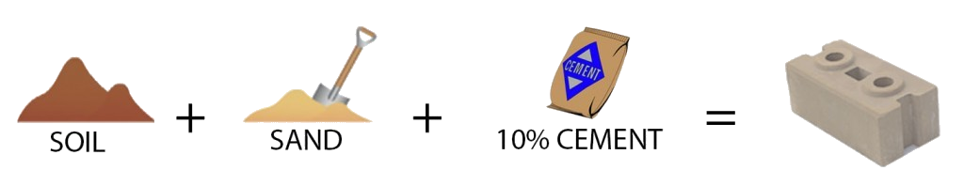
03
Walls
CSEB Bricks
Compressed Stabilized Earth Brick
Courtesy: Build Up Nepal
Notes:
-Mixture of soil sand and cement
- Walls had to be certain weight to counteract the forces applied by earthquake

Slide 10

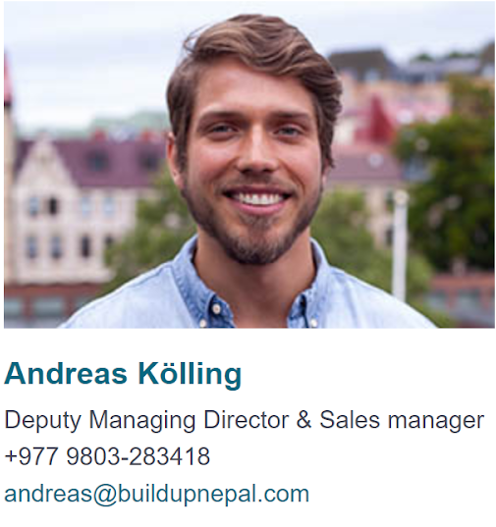
High thermal mass
Reinforced with iron rods
Easily produced with local materials
Cheaper alternative to firebricks.
294795 NRS ($3933 NZD).
Notes:
-Organisation which specialises in earthquake relief projects in Nepal
-Sent them an email, got a reply outlining benefits of CSEB, estimated budget of house
-$7029 NZD for fired bricks

Slide 11
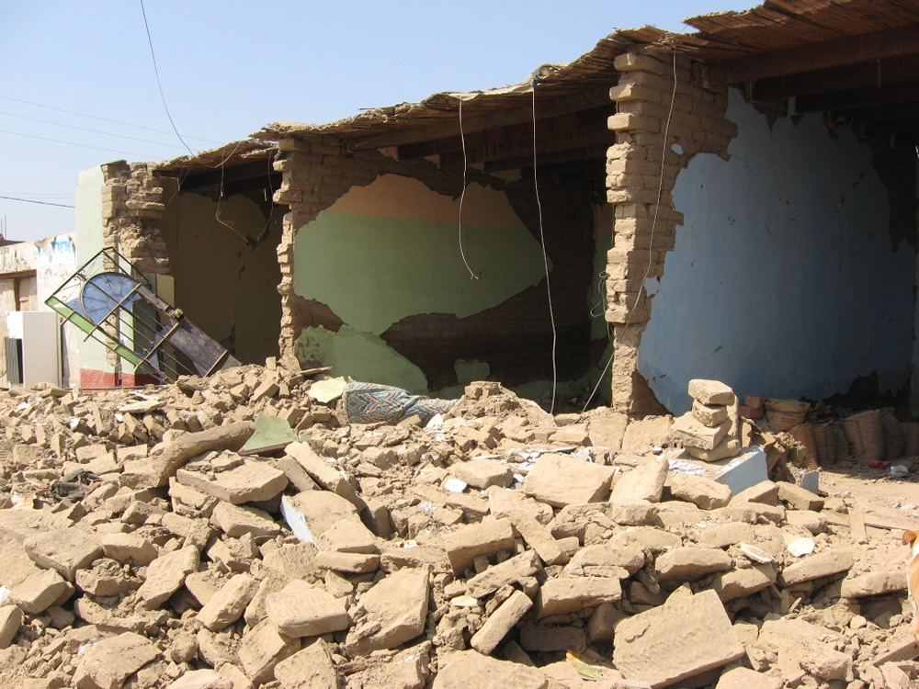

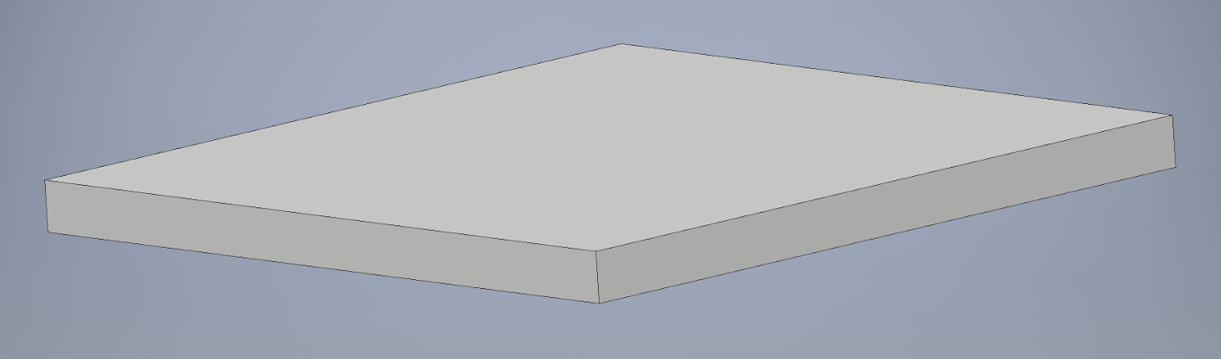
04
Foundation
Rubble of old house
Images courtesy (left to right) World Housing Encyclopaedia, Wikipedia,
Notes:
-Essentially creation out of destruction
- Recycling rubble from old houses to form a flat foundation for the new house to sit on

Slide 12
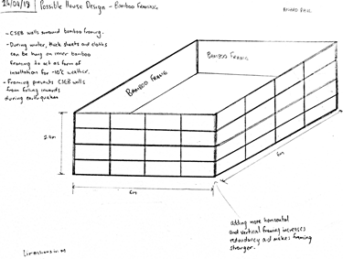
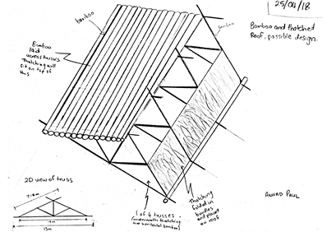
Concepts.
Roof
Body
Anhad’s Concept

Slide 13
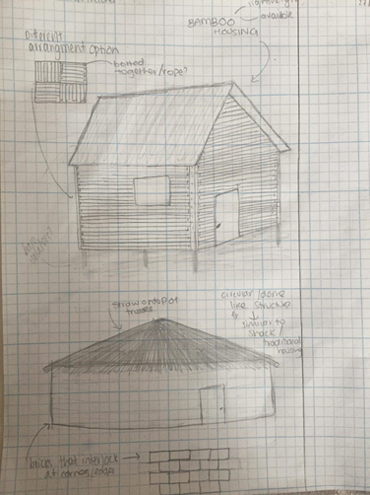
Concepts.
Grace’s Concept

Slide 14
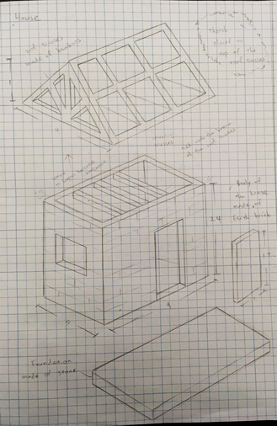
Concepts.
Tina’s Concept

Slide 15
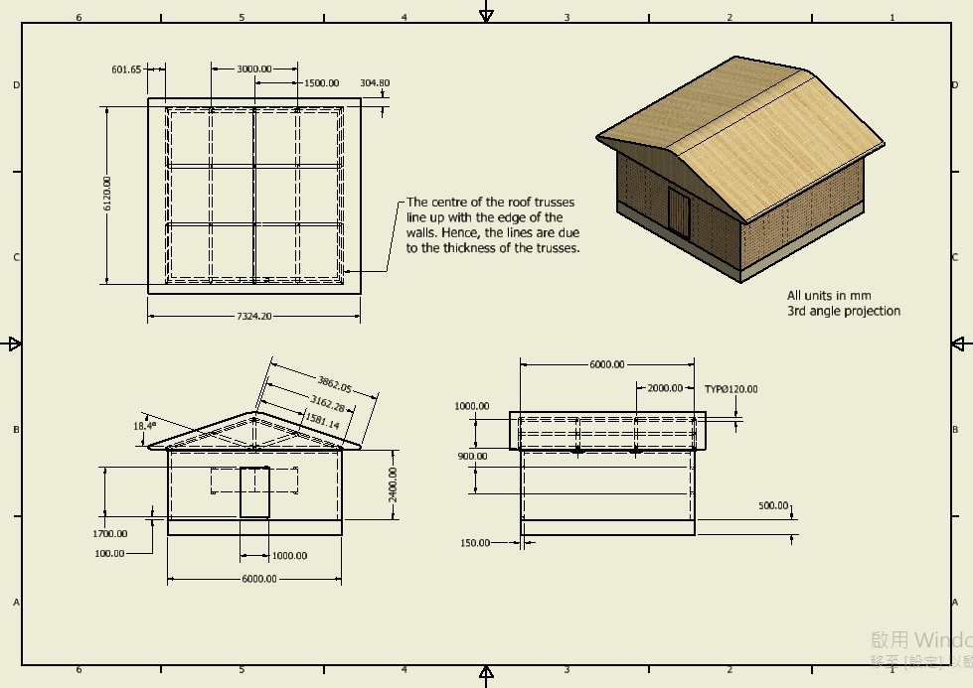
Notes:
After combining all our concepts we came up with a final design as shown. It is a symmetrical house with dimensions 6x6x2.4m. when a symmetrical house experiences an earthquake, the forces acting on it will divided equally among house. This will help stabilize the structure during the earthquake.

Slide 16
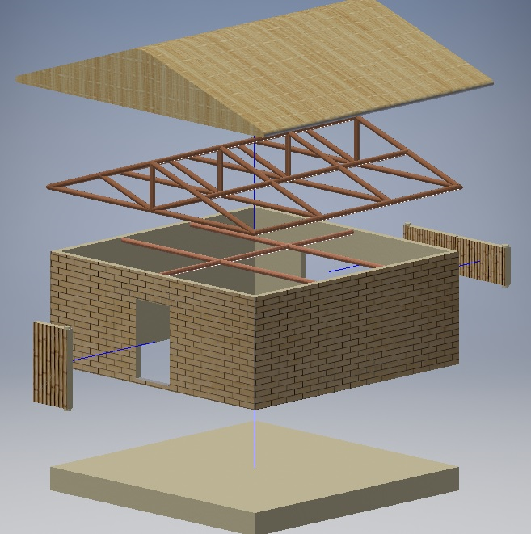
Temperature & Earthquake Proof
Features that control the temperatures…
Thatched roofing
Compressed Stabilised Earth Bricks
Windows and door
Features that make it an earthquake proof house...
Lightweight roof materials
Iron bars reinforcement
Horizontal bamboo support
Notes:
Thatched roofing and earth bricks both act as good insulators which help maintaining a comfortable temperature inside the house during different seasons.
The roof of the house consists of bamboo trusses and thatched roofing they are lightweight materials. Which is good because there will be less side to side motion during an earthquake.
The multiple bamboo roof trusses also add redundancy to the house which allows it to maintain equilibrium when large forces are applied to it.
To strength the structure the walls will be reinforced using iron bars which will be embedded inside the CSEB walls. Iron has high ductility which means it is able to resist a large force from earthquake until breakin.

Slide 17
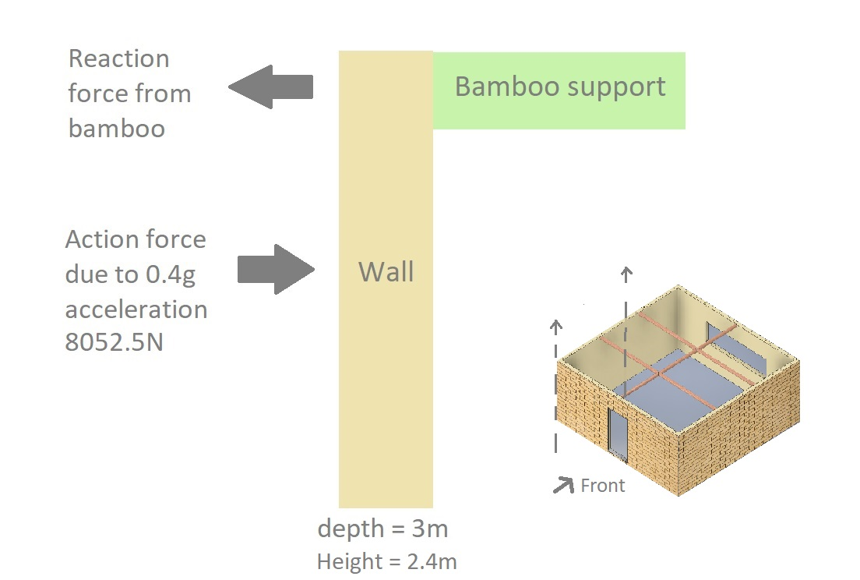
How does the house resist 0.4g?
For the house to be stable during an earthquake
∑M clockwise = ∑M anti-clockwise
The clockwise moment due to 0.4g is 9662 Nm.
A bamboo support can resist a max moment of 1042712 Nm.
Notes:
A horizontal supporting bamboo is embedded to support 3m of the wall a shown. 0.4g earthquake produces a force of approximately 8000 newton through the COM of one earth brick wall. Using moment calculation, the supporting bamboo must be able to resist 4000N to counteract the force due to earthquake and stabilize the house.
It is found that bamboo has high compressive strength and can resist up to 445 kN when being compressed. Therefore this has proven that the house we designed can resist 0.4g earthquake.

Slide 18
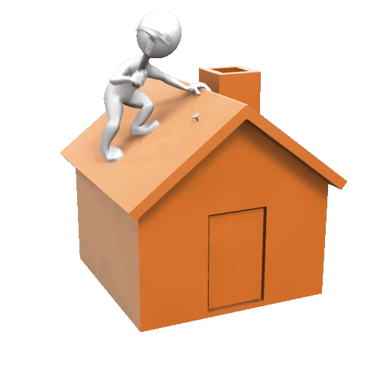
Challenges
Some challenges we faced….
Finding relevant costs to build the house
Finishing the design within the time limit
Figuring out a structure to resist 0.4g
Limited materials are available
Notes:
I believe everyone can relate…..However, we overcame these challenges by dividing all the tasks and….. Came up with a final design which meets all the requirements.

Slide 19
Final Design!!!
Notes:
Here it is!!! Our final design!

Slide 20
Thank you.

